Slide 1

Manhattan vs Old Toronto
Project for IBM Data Science Professional Certificate

Slide 2
Borough’s demographics
Manhattan 3.5 times more crowded than Old Toronto
Old Toronto has half the population of Manhattan
Old Toronto covers 65% more land than Manhattan

Slide 3
Borough’s venues
Old Toronto has 126 coffee places, 292 restaurants and 74 bars
Manhattan has 152 coffee places, 893 restaurants and 243 bars

Slide 4
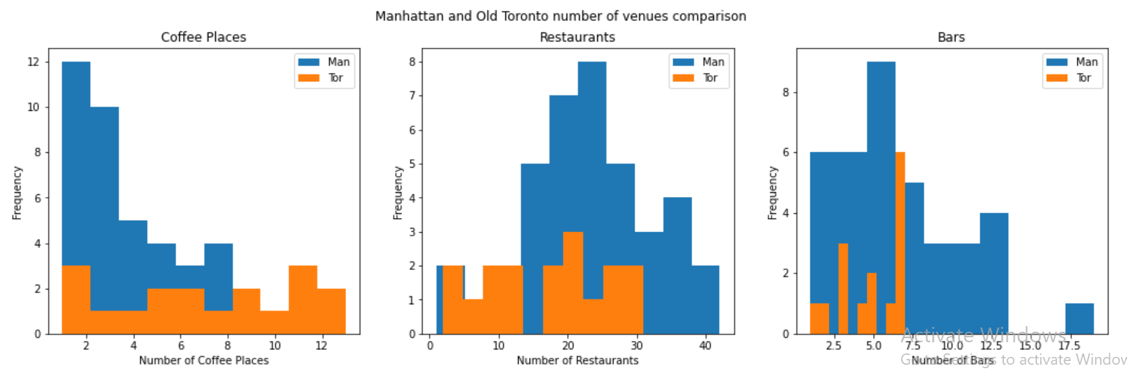
Borough’s venues with Graphs

Slide 5
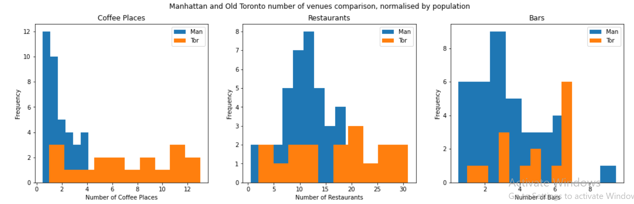
Borough’s venues with Graphs

Slide 6
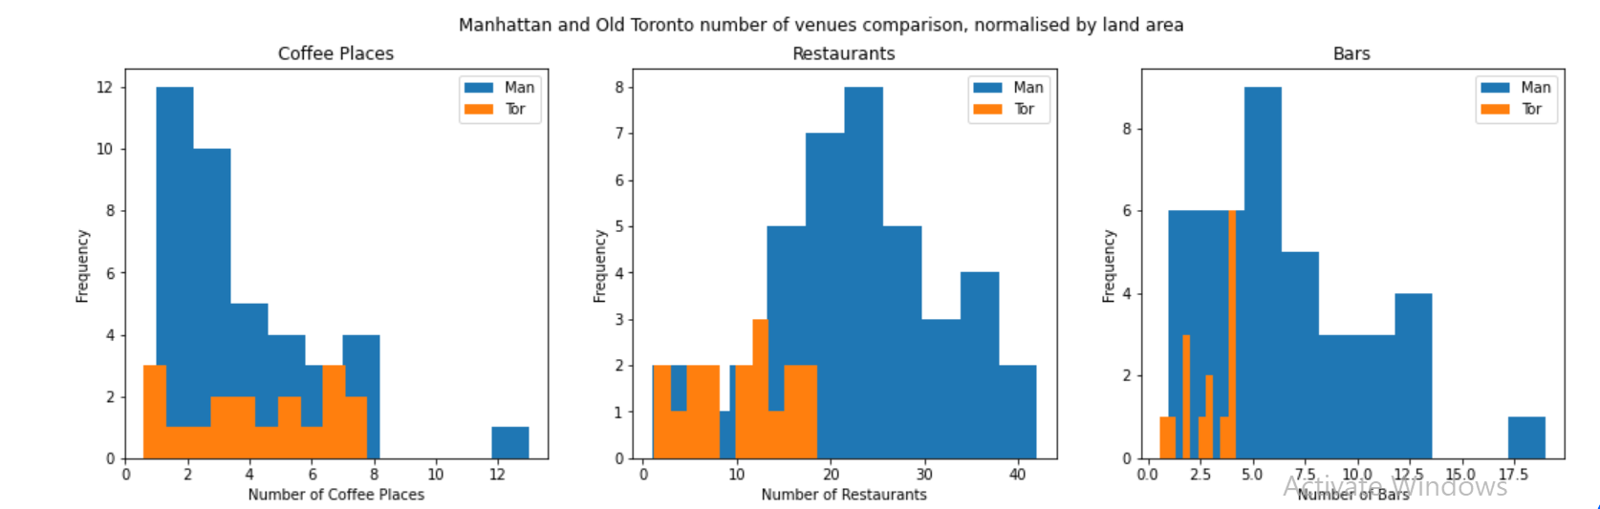
Borough’s venues with Graphs

Slide 7
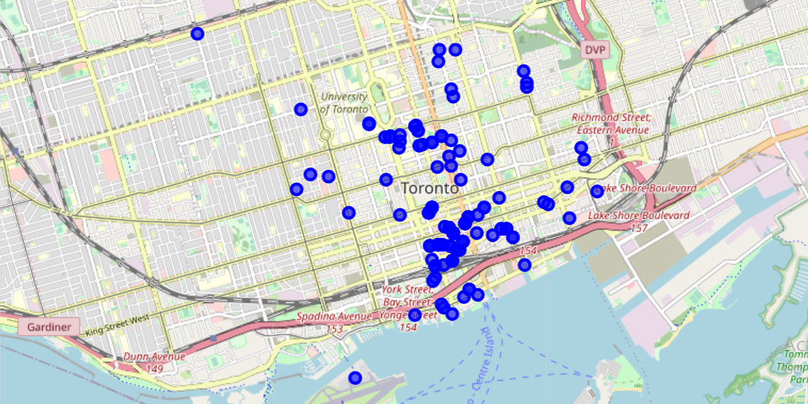
Old Toronto Coffee Shops

Slide 8
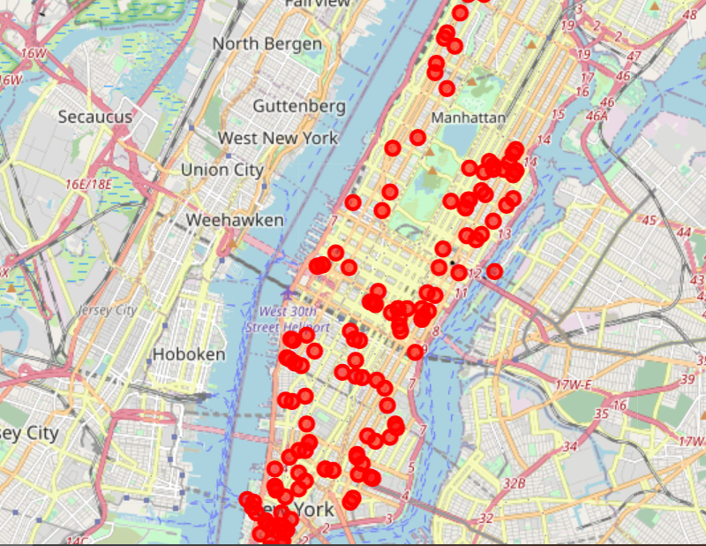
Manhattan Coffee Shops

